Slide 1


STIGMA 101
Understanding and Eliminating Stigma Associated with Mental Health Challenges &
Substance Use Disorders (SUD)
eliminatestigma.org

Slide 2
  Background on Rogers Behavioral Health and WISE Initiative for Stigma Elimination
AGENDA
  The components of stigma
"What mental health needs is more sunlight, more candor, and more unashamed conversation" - Glen Close
  The ongoing impact of stigma
  Research on what impacts stigma
  What you can do today
Notes:
Feel free to update the agenda to fit your needs and the content within the presentation

Slide 3

Rogers Behavioral Health Today
Rogers is a nationally recognized, not-for-profit provider of evidence-based mental health and addiction services
What we treat:
24,280⁺ admissions a year
1,500⁺ patients treated each day
Offers in-patient, residential, partial hospitalization, and intensive outpatient services at our various locations
OCD and anxiety
Depression
Addiction
Eating disorders
Trauma
Anxiety and depression in
autism spectrum disorders
Offering TMS services
The Quality of Life Enjoyment and Satisfaction Questionnaire measures the degree of enjoyment and satisfaction Rogers’ patients experience their daily lives.
37%
increase
Rogers is located in 10 states: California, Colorado, Florida, Georgia, Illinois, Minnesota, Pennsylvania, Tennessee, Washington, and Wisconsin
**How to refer? Call Admissions: 414-865-2500**
Notes:
Feel free to swap out/add a slide to incorporate your organization where you see fit

Slide 4

WISE
The WISE Initiative for Stigma Elimination is a nationwide coalition of organizations and individuals promoting inclusion and support for those affected by mental illness and addiction/substance use. Rogers’ Community Learning and Engagement staff coordinates the work of WISE.
www.eliminatestigma.org
Notes:
People with mental health challenges sharing their recovery experiences in a targeted, local, credible and continuous way is the current, primary, evidence-based practice to reduce stigma, and drives the focus of WISE. We promote the power of strategic contact with people in recovery to end stigma in schools, healthcare, congregations, workplaces and wherever humans interact.
WISE Values: Wholeness, Integrity, Story, Continuous Learning, Change Agency
Overview of programs: WiseOverview_022324.indd

Slide 5

Understanding Similar Yet
Different Terms
Mental Health:
Talks about our mental well-being: our emotions, our thoughts and feelings, our ability to solve problems and overcome difficulties, our social connections, and our understanding of the world around us.
Mental Illness:
Is an illness that affects the way people think, feel, behave, or interact with others. There are many different mental illnesses, and they have different symptoms that impact peoples’ lives in different ways.
Notes:
‘Mental health’ and ‘mental illness’ are increasingly being used as if they mean the same thing, but they are not. Everyone has mental health, just like everyone has physical health. As the World Health Organization famously says, “There is no health without mental health.” In the course of a lifetime, not all people will experience a mental illness, but everyone will struggle or have a challenge with their mental well-being (What’s the difference between mental health and mental illness? | Here to Help).
When we talk about mental health, we’re talking about our mental well-being: our emotions, our thoughts and feelings, our ability to solve problems and overcome difficulties, our social connections, and our understanding of the world around us. Mental illness is an illness that affects that way people think, feel, behave, or interact with others. There are many different mental illnesses, and they have different symptoms that impact peoples’ lives in different ways.

Slide 6

Examples of Mental Health Challenges
Depression
Schizophrenia
Eating Disorders
Substance Use Disorders
Trauma
Anxiety
and many more...
Notes:
We use “mental health challenge” as an umbrella to both mental health and mental illness. Knowing that they both have different meanings, it is a way of not excluding or offending anyone. What you see, understanding that these are just some examples of mental health challenges people are faced with.
What are some other mental health challenges that come to mind for you?
Raise your hand if you or someone you know has experienced a mental health challenge?

Slide 7

1 in 5 people will experience a mental health challenge in any given year.
Notes:
Mental Health Challenges, more specifically, mental illnesses are common in the United States. It is estimated that more than one in five U.S. adults live with a mental illness (57.8 million in 2021) and/or substance use disorders. Mental illnesses include many different conditions that vary in degree of severity, ranging from mild to moderate to severe. Two broad categories can be used to describe these conditions: Any Mental Illness (AMI) and Serious Mental Illness (SMI). AMI encompasses all recognized mental illnesses. NIMH » Health Topics (nih.gov)

Slide 8
WHAT IS STIGMA?
DEFINITION | TYPE
Stereotypes | Internalized
Prejudice | Public
Discrimination | Structural
Oppression
Notes:
Stigma can be described with three words- stereotypes (ideas), that lead to prejudice (beliefs), that lead to discrimination (action). When discrimination takes place in the context of a power differential, this becomes oppression. One might argue that there is a power differential in most relationships so we might simply say oppression instead of stigma.
It comes in the form of public, internalized shame for those experiencing mental health challenges, and structural (policies and processes that reinforce discrimination) stigma.
In the next few slides, you will have the opportunity to see Briden’s (slide 9 first pic) and Tajuanna’s (slide 11 second pic) story as it relates to stigmatizing beliefs.
Understand Stigma – Understand Stigma – WISE Initiative for Stigma Elimination

Slide 9



Stereotypes - Ideas
"People with mental health challenges are incapable, fragile, dangerous, cannot recover."
STIGMATIZING THOUGHTS AND BELIEFS
Prejudice - Beliefs
"People with mental health challenges are less than."
Notes:
Stereotypes: “are a generalized belief about a particular category of people.^{[2]} It is an expectation that people might have about every person of a particular group. The type of expectation can vary; it can be, for example, an expectation about the group's personality, preferences, appearance or ability. https://en.wikipedia.org/wiki/Stereotype
Prejudice: preconceived opinion that is not based on reason or actual experience.

Slide 10



Discrimination - Actions
"I won’t hire someone with a mental health challenge."
Oppression
STIGMATIZING ACTIONS
Institutional, organizational, or governmental limitations to availability, accessibility, or acceptability. Discrimination backed by a system of power.
Notes:
Discrimination: the unjust or prejudicial treatment of different categories of people, specifically regarding social identities such as: ethnicity, age, sex, and disability.
Oppression: ” A system of mistreatment, exploitation and abuse of a marginalized group(s) for the social, economic or political benefit of a dominant group(s).” https://www.adl.org/resources/tools-and-strategies/education-glossary-terms

Slide 11

I am not good
Self Esteem
I am unable
Efficacy
Why try?
Avoidance, anger, apathy
PUBLIC STIGMA
Notes:
Internalized shame is another way to refer to self-stigma and perhaps says it better.
Once again, when we explore what works to reduce stigma, you will see how reducing discriminatory behaviors and reducing internalized shame rely on the same approach.
Potential questions for audience:
1) How do you suppose internalized stigma or shame may impact people’s willingness to access support/care/treatment/services?
2) Since self-stigma usually comes from public stigma, what are some common or frequently occurring forms of self-limiting/hurtful self-beliefs? (e.g., I’ll never recovery, I’m a bad person). Note to facilitator: you can make this question generally applicable to mental health (e.g., I’ll never recover) or specific to issues you and your audience are focused on (e.g., for dual-diagnosis – I’ll always be an addict; for suicidality – I am a burden; for males with depression – Men never cry….)

Slide 12
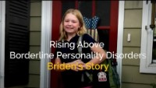

Recovery Stories – Stigmatizing Beliefs and Actions
Notes:
Choose one of the videos (depending on the audience) to watch to reflect.
After watching the video:
What are thoughts you have and statements you heard from Briden and Tajuanna regarding stigma or mental health?
Take some to reflect on your own thoughts…what stigmatizing beliefs do you have of yourself?
How have your behaviors been informed by those beliefs?
What have you done to change your perspective and thoughts about yourself and others as it relates to mental health challenges?

Slide 13
OKAY, BUT ISN'T IT BETTER LATELY?
Impact on Adolescents
Impact on
Adults
  Low self esteem
  Bullying
  Lower academic achievement
  Increased social isolation
  Unemployment
  Worse healthcare
  Lost employment
  Sub-par housing
  Diminished education opportunities
Notes:
These categories come from research with people who have a lived experience of mental illness. They report oppressive behaviors by people in these sectors as deterrents to their recovery. What one thinks about a person cannot be known for sure. One’s actions are concrete and observable. Regardless of intention, when the outcome of an action is a deterrent to another’s rights, we have a responsibility to bring that to the light and work together to create a positive communal response.
Being victims of bullying
The negative beliefs and stereotypes about mental illnesses have been used to justify bullying teens with such conditions.
Experiencing discrimination
Mental health stigma can lead to discrimination, whereby adolescents with mental health issues are treated differently or poorly because of their condition. These adolescents then often have fewer opportunities for education, employment, and social activities.
Having limited access to quality healthcare
Mental health stigma can translate to the neglect or unwillingness of the political system to allocate public funds toward mental health services. Some insurance companies also do not cover psychiatric therapy and medication. This is why teens with mental illnesses may receive poorer quality of care or have difficulty even receiving any form of care. In fact, 31% of American adolescents have tried to avail mental healthcare but found it too hard to figure out where to go.
Having decreased self-esteem and resorting to self-isolation
The stigmatization from their family, peers, and community can negatively impact how adolescents view themselves and how they interact with others. A 2010 study of stigma among teens taking psychiatric medication found that many of the participants are afraid of being bullied by their peers in school. Consequently, 90% of them displayed at least one of the three measured stigma themes: secrecy, shame, and limiting social interaction.
Being unwilling to seek treatment or feeling shame for doing so
Mental health stigma prevents adolescents from getting the help they need. And when they do seek treatment, they feel shame for doing so. In fact, 49% of Americans from Generation Z worry about others judging them when they say they’ve sought mental health services.
Having poor overall health condition
When adolescents with mental illnesses don’t get help, they tend to self-medicate with drugs, alcohol, or cigarettes, which can lead to substance abuse. Some also develop behaviors that adversely affect their health like eating disorders or social media addiction to cope with negative stigma. In fact, nearly one in two Americans from Generation Z experienced the adverse effects of poor mental health on their physical health.
For example, for employment:
Past research has shown that most people with serious mental disorders are willing and able to work. [8,13] Yet, their unemployment rates remain inordinately high. For example, large-scale population surveys have consistently estimated the unemployment rate among people with mental disorders to be three to five times higher than their nondisabled counterparts. Sixty-one percent of working age adults with mental health disabilities are outside of the labor force, compared with only 20% of working-age adults in the general population. [14*] Unemployment rates also vary by diagnostic group from 40 to 60% for people reporting a major depressive disorder to 20-35% for those reporting an anxiety disorder. Unemployment rates for people with serious and persistent psychiatric disabilities (such as schizophrenia) are the highest, typically 80-90%. [15] As a result, people with serious mental disabilities constitute one of the largest groups of social security recipients. [16*,17**] Oppression of people with mental illness in the work place is a deterrent to an individual’s recovery and to our community having access to valuable human input by those with mental health challenges. WISE works with organizations to implement effective practices to reduce workplace stigma.

Slide 14
WHAT CHANGES STIGMA?
“The stigma of severe mental illness leads to prejudice and discrimination. Stigmas are negative and erroneous attitudes about these persons. Unfortunately, stigma's impact on a person's life may be as harmful as the direct effects of the disease."
- Dr. Corrigan
Notes:
If stigma still exists in our society and is negatively impacting those with mental health challenges, what can we do to eliminate stigma? Education, advocacy, and contact are the ways people have tried to decrease stigma. Let's take a look at the research of Dr. Pat Corrigan, international stigma reduction expert from the Illinois Institute of Technology, and other researchers and articles as to the most effective ways of decreasing stigma.

Slide 15
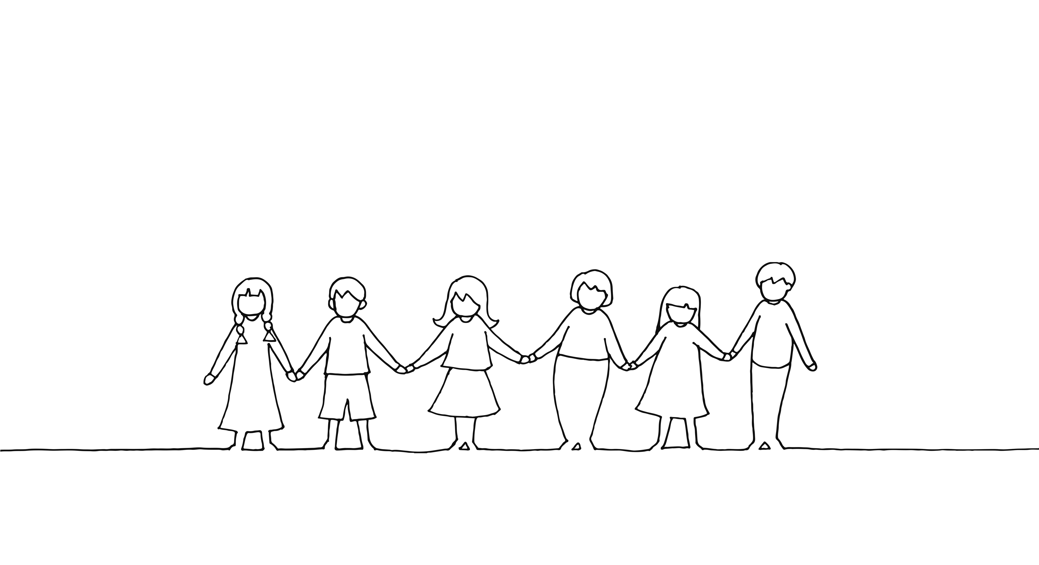
Research Findings on Stigma in Relation to Education and Contact Approaches with Adolescents and Adults
Dr. Corrigan found that both education and contact have benefits in changing stigma amongst adolescents and adults.
The effectiveness of contact and education varied depending on the age group.
Notes:
Contact, defined by Dr. Corrigan, is the face-to-face interaction people have to tell their stories as it relates to mental health challenges. This face-to-face contact also helps with building connection to get to know a person better to help with decreasing stigmatizing beliefs and thoughts surrounding those with mental health challenges. Dr. Corrigan defined education as teaching participants about mental illness as a brain disorder, coupled with evidence that common stereotypes of people with mental health challenges are not true.
While education and contact were both found to reduce stigmatizing beliefs, the effectiveness of both varied depending on the age group.
https://ps.psychiatryonline.org/doi/full/10.1176/appi.ps.201100529

Slide 16

Research Findings on Stigma in Relation to Education and Contact Approaches with Adolescents and Adults
Adolescent findings:
  “Perhaps the difference emerged because adolescents’ beliefs about mental illness are not as firmly developed as adults and adolescents therefore are more likely to be responsive to education effects.”
  Education vs education w/ contact approach – education results found to have better results than education w/ contact.
  Education has a more significant impact on stigma reduction in youth. Mental Health Literacy worsened over time with contact and education combined compared to just education.
  More research is needed in stigma reduction efforts in youth to see what measures reduce stigma over time.
Corrigan, P.; et al. (2012). Challenging the Public Stigma of Mental Illness: A Meta-Analysis of Outcome Studies. Washington DC: American Psychiatric Publishing
Fretian, A.; et al. (2021). The Long-Term Effectiveness of Interventions Addressing Mental Health Literacy and Stigma of Mental Illness in Children and Adolescents: Systematic Review and Meta-Analysis. Germany: Int J Public Health
Notes:
Mental Health Literacy is defined as: “knowledge and beliefs about mental disorders which aid their recognition, management, or prevention”.
Mental Health Stigma is defined as: “someone is marked or discredited somehow or reduced from being a whole person to being a stereotype or labelled as a collection of symptoms or a diagnosis”.
https://www.healthdirect.gov.au/mental-illness-stigma
From the articles, adolescents receive their information regarding mental health in the school setting. It is not explained why MHL worsened over time in youth with both contact and education compared to just education. However, even though education had a significant impact on stigma reduction in youth, contact/contact and education did not have less of an impact on youth. More research is needed in stigma reduction efforts in youth to see what measures reduce stigma over time.
https://www.ssph-journal.org/articles/10.3389/ijph.2021.1604072/full
https://ps.psychiatryonline.org/doi/full/10.1176/appi.ps.201100529

Slide 17

Research Findings on Stigma in Relation to Education and Contact Approaches with Adolescents and Adults
Adult findings:
From the National Library of Medicine:
“the contact approach is the most effective”
Found that 1:1 contact was the most effective at reducing stigma than a group listening to a person’s mental health recovery journey – in person was more effective than video taped
Shahwan, S.; et al. (2022) Strategies to Reduce Mental Illness Stigma: Perspectives of People with Lived Experience and Caregivers. Int J Environ Res Public Health
Notes:
Contact approach is found to have a more significant impact on adults.
We take in information and integrate it into our thinking, beliefs and behaviors most readily when it comes from someone, we consider a peer- someone like us- who understands us and our lives.
Why videotaped is not as effective: “Videotaped contact has the potential for a broad audience: disseminating the video via a variety of online platforms and television networks exponentially increases exposure of the Anti stigma effort compared with face-to-face approaches. In-person contact leads to better effects, but both types of contact significantly diminish stigma.”

Slide 18

Contact Approach -
CREDIBLE Contact?
Contact with peer
  Nurse to nurse
  Pastor to pastor
  Athlete to athlete
Notes:
We take in information and integrate it into our thinking, beliefs and behaviors most readily when it comes from someone we consider a peer- someone like us- who understands us and our lives.
Credible does NOT mean famous.
A Packer player talking about his experience of mental health challenges has less of an impact than someone like you.
You can see that the peer-support programs in our world are crucial to a cultural transformation around mental healthcare and self and public stigma.
Potential question for audience:
1) How do we determine who/what would be deemed credible among our target audience?

Slide 19
WHAT CAN YOU DO TODAY TO REDUCE STIGMA?
Maintain recovery perspective on a daily basis- proactively seek out stories. | Reinforce & support resilience & recovery in others.
Create curiosity - be prepared to speak up when you see stigma. | Consider the story you can tell about recovery.
Bring the conversation to your community. | Be a safe and supportive person when someone needs it.
Challenge your own stigmatizing beliefs you may hold about those who experience a mental health conversation. | Tend to your own wellbeing.
Notes:
Dr. Corrigan’s research has highlighted the importance of hearing and learning from others’ stories. Take time to seek out others mental health stories to help combat your own stigma. And consider which parts of your story you are willing to share with others.
Be an active listener and highlight the resilience you see in those who seek out your support. You can be the safe and supportive person someone is looking for.
When you hear or see something that appears to be stigmatizing, get curious. Ask the person or people who shared the stigmatizing belief about what they meant by their comment and use parts of your story to illustrate the harm that comment has on people with mental health challenges.
Seek out opportunities to talk about mental health and stigma in the communities you are part of. Explore how you can use story and education to make these spaces more aware and inclusive.
Make sure you are taking care of you! When we are drained, we are much more likely to act on stigmatizing beliefs we hold. Tending to your own well-being will make it less likely that you stigmatize others.
Open it up to the group for additional suggestions on actions the group can take to reduce stigma.

Slide 20
COMPASSION RESILIENCE
UP TO ME
STIGMA 101
SAFE PERSON
The Up to Me curriculum helps people make choices on whether and how they share about mental health and other conditions. There are four available curriculums: Up to Me (Adult), Up to Me (Teens), Up to Us (Family), Up to Me - Tourette.
This presentation and facilitated discussion is a great place to start for any group looking to increase inclusion, support and hope for people living with mental health and substance use challenges.
Displaying the Safe Person Decal indicates your desire to be a safe person for others. In doing so, you promise to listen and support by observing the Safe Person Decal 7 Promises.
The Compassion Resilience Toolkits provide support and resources to help organizations, teams, and caregivers build and maintain a culture of well-being and compassion. There are three available toolkits: Schools, Health and Human Services, and Parent and Caregiver.
www.eliminatestigma.org
Notes:
While looking at what you can do today, WISE is a resource that helps with having continuous conversations on how to lessen stigma in our community. Once there is an understanding on what stigma is, you can then begin to think about the direction you want to go, and WISE has different programs to help with not only eliminating stigma, but also increasing awareness on mental health challenges and being an advocate and supporter of those in your family and community.
Brief description on each program that is offered to those wanting to learn, be trained, tell their story, or to just keep the conversation on stigma and mental health challenges going to build awareness. All these programs can be found at www.eliminatestigma.org

Slide 21
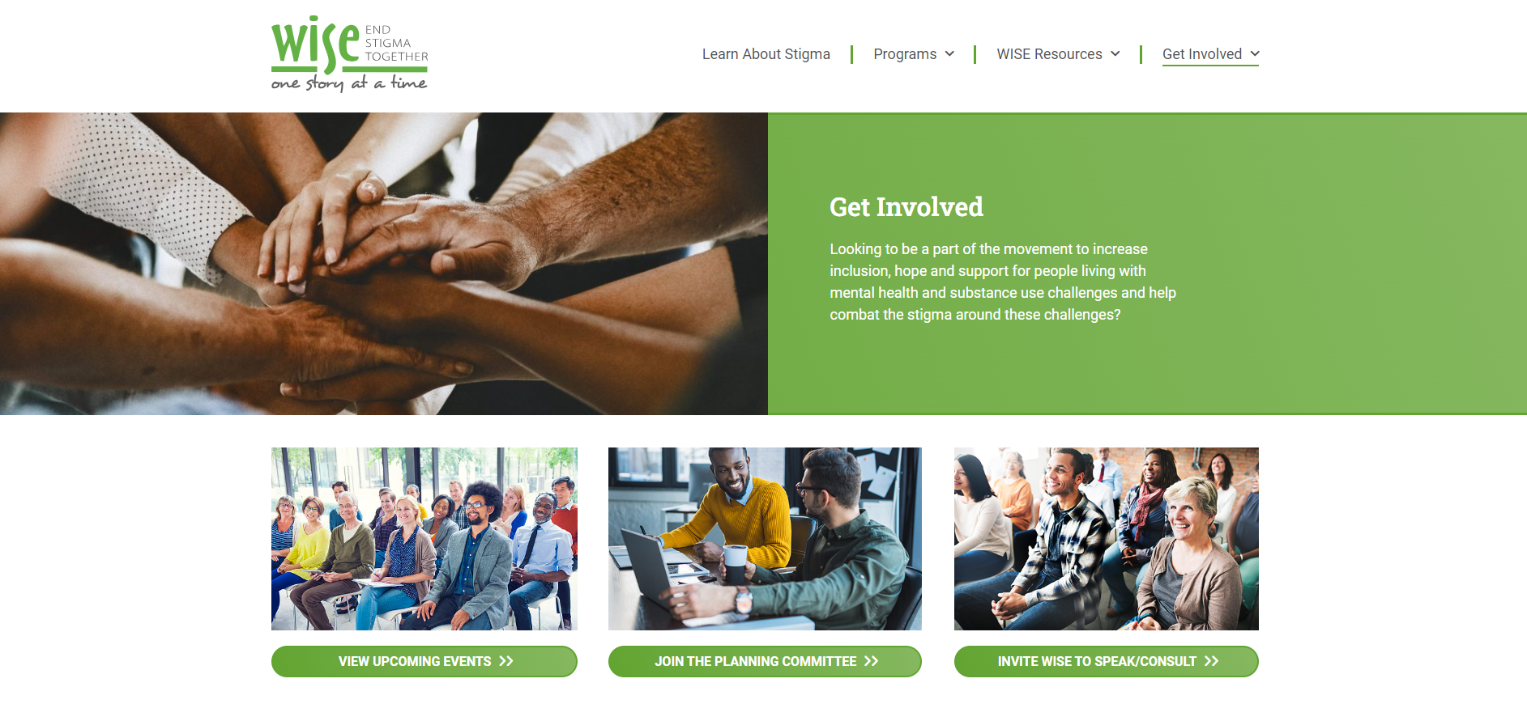

WISE Initiative for Stigma Elimination
Hosts free educational meetings and lunch and learns to explore different topics related to mental health and substance use disorders through the lens of reducing stigma. To view upcoming events, speakers, topics and to sign up for the newsletter visit www.eliminatestigma.org.
WISE Initiative for Stigma Elimination
Notes:
If you would like to learn more about how to combat stigma, be sure to check out WISE’s free, virtual educational opportunities. You can find out how to register for these events (as well as view past recorded events), access our video library of people sharing their stories, and join WISE’s mailing list by visiting www.eliminatestigma.org.
WISE Facebook page – Updates on stigma reduction in communities across the country as well as upbeat, positive messaging.

Slide 22
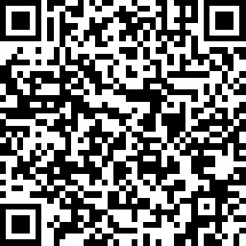
QUESTIONS?
Thank you!
eliminatestigma.org
Stigma 101 Survey
Notes:
https://www.surveymonkey.com/r/Stigma101Eval
Invite participants to scan the QR code on the slide to complete the survey to provide feedback.
The email on the slide is also a resource to reach out to participants wanting to further their involvement with WISE: eliminatestigma.org

